Slide 2

SPARC M7
Software on Silicon
Martin Müller
Software Engineer
Oracle Microelectronics
martin.x.mueller@oracle.com

Slide 3
THE FOLLOWING IS INTENDED TO OUTLINE OUR GENERAL PRODUCT DIRECTION. IT IS INTENDED FOR INFORMATION PURPOSES ONLY, AND MAY NOT BE INCORPORATED INTO ANY CONTRACT. IT IS NOT A COMMITMENT TO DELIVER ANY MATERIAL, CODE, OR FUNCTIONALITY, AND SHOULD NOT BE RELIED UPON IN MAKING PURCHASING DECISIONS. THE DEVELOPMENT, RELEASE, AND TIMING OF ANY FEATURES OR FUNCTIONALITY DESCRIBED FOR ORACLE'S PRODUCTS REMAINS AT THE SOLE DISCRETION OF ORACLE.

Slide 4
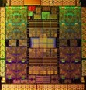
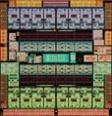
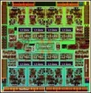
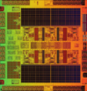
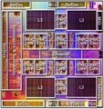
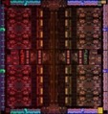

SPARC @ Oracle
}
App Data Integrity
DB Query Acceleration
Inline Decompression
More….
Including
Software in Silicon
7 Processors in 6 Years
2010
2011
2013
2013
2013
2015
. . .
SPARC T3
SPARC T4
SPARC T5
SPARC M5
SPARC M6
SPARC M7
Low Cost SPARC
16 x 2nd Gen cores
4MB L3 Cache
1.65 GHz
8 x 3rd Gen Cores
4MB L3 Cache
3.0 GHz
16 x 3rd Gen Cores
8MB L3 Cache
3.6 GHz
6 x 3rd Gen Cores
48MB L3 Cache
3.6 GHz
12 x 3rd Gen Cores
48MB L3 Cache
3.6 GHz
32 x 4th Gen Cores
64MB L3 Cache
4.1 GHz
8 x 4th Gen Cores
16MB L3 cache
IB
Notes:
T5-2 mem b/w 79 / 46 GB/s (local/remote)
T7-2 mem b/w 159 / 68 GB/s (local/remote)
Measured STREAM triad b/w

Slide 5
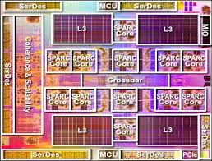
Chip Advances in the Last Decade
Focus on better/faster general purpose chip
More CPU cores per chip
Memory & PCI interfaces moved on-chip
Improved pipelines, branch prediction, cache coherency, reliability, clock rates, etc.
New Functionality: encryption, vector processing, virtualization
  Encryption on-chip is 10X faster and frees CPU cores to do other work
  Database optimizations on chip are analogous

Slide 6

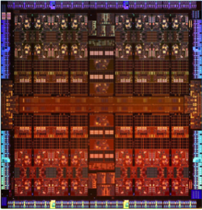

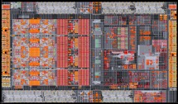


Lower Latency, Lower Power, and Cost for Scale-Out
M7
DDR4 Interfaces
DDR4 Interfaces
Sonoma
Scale-Up
PCIe Gen3 Interfaces
InfiniBand
Scale-Out
6

Slide 7
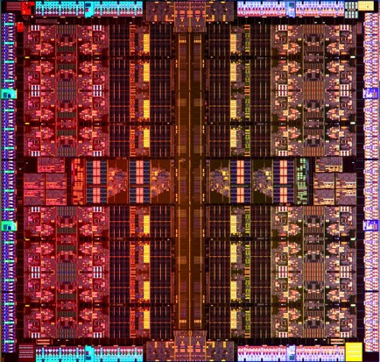
Advancing the State-of-the-Art
M7 Microprocessor – World’s First Implementation of Software Features in Silicon
SQL in Silicon
  High-Speed Memory Decompression
  Accelerates In-Memory Database
Always-On Security in Silicon
  Memory intrusion detection
High-Speed Encryption
  Near zero performance impact
Notes:
Option to Run on Secure Silicon in the Cloud

Slide 8
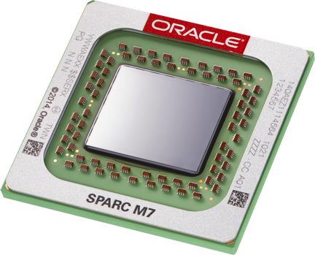
SQL in Silicon
Speeding Up “inmemory” Processing in the Oracle 12c Database (12.1.0.2 BP13)

Slide 9

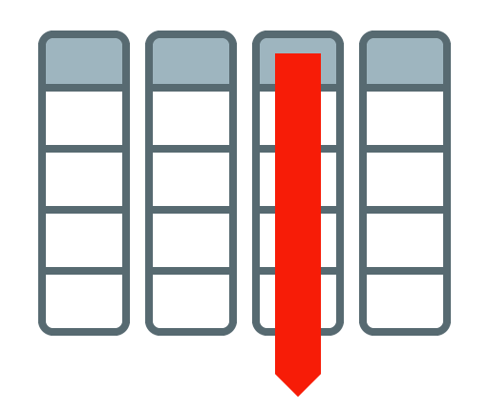






Dual Format Database “in-memory In a Nutshell”
Memory
Memory
BOTH row and column formats for same table
Simultaneously active and transactionally consistent
Analytics & reporting use new in-memory Column format
OLTP uses proven row format
“Two stage” compression
  Column header
  Column contents (“memcompress for ...”)
Memory
SALES
SALES
Compressed
Column
Format
SALES
Row
Format
Column
Format
11/02/16

Slide 10
Database In-Memory Acceleration Engines
New SPARC chip uses dedicated acceleration engines built on chip
  Independently process streams of unaligned database column elements of any size
    E.g. find all values that match ‘California’
Frees CPU cores to run higher level SQL functions
Reads data directly from memory and places results in cache for core consumption
  Shared cache provides ultra-fast communication
SPARC CPU
Core
Core
Core
Core
Shared Cache
DB Accel
DB Accel
DB Accel
DB Accel
11/02/16

Slide 11
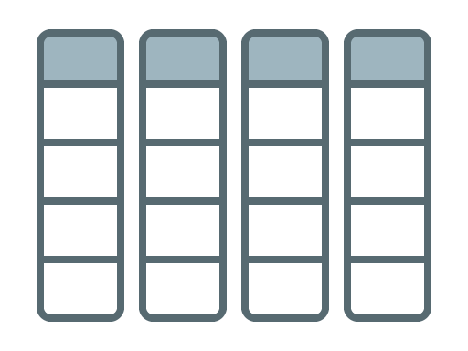




Analytic Scans using “in-memory”
Memory
Many values loaded in one step
SIMD operation works on more than one value at a time
Padding required to fit into fixed width SIMD register
  SIMD register is 8, 16, or 32 bits wide
  in-memory values are contiguous
Example:
Find all sales
in region of CA
REGION
CPU
Load
multiple
region
values
CA
Vector
Compare
all values
an 1 cycle
Vector Register
CA
CA
CA
Notes:
The Oracle in-memory column format is designed to enable very fast SIMD processing (single instruction processing multiple data
values). You can imagine SIMD or vector processing as array processing.
SIMD was originally designed for accelerating computer generated animation and High Performance Scientific computing.
Lets assume we are looking for the total number of sales we have had in the region of California this year.
The sales table is stored in the In-Memory Column Store so we simply have to scan the state column and count the number
of occurrence of the state of California. With SIMD processing we can check 16 values or entries in the state column in a single CPU cycle.
Columnar speed comes from
Scanning only needed columns
SIMD optimized format
Column specific compression algorithms

Slide 12
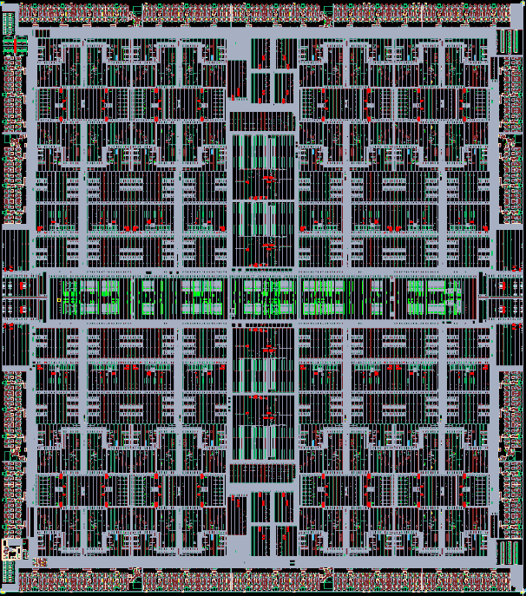
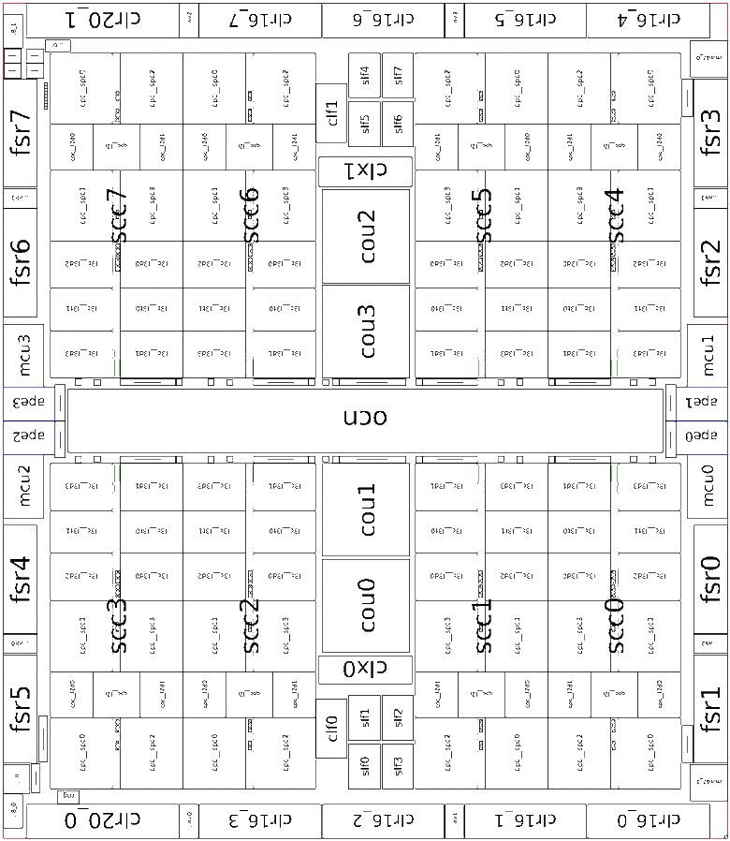



Analytic Scans using “in-memory”
Memory
Example:
Find all sales
in region of CA
REGION
Large amounts of data
not needed or used!
CPU
Load
multiple
region
values
CA
Vector
Compare
all values
an 1 cycle
Vector Register
CA
CA
CA
Notes:
The Oracle in-memory column format is designed to enable very fast SIMD processing (single instruction processing multiple data
values). You can imagine SIMD or vector processing as array processing.
SIMD was originally designed for accelerating computer generated animation and High Performance Scientific computing.
Lets assume we are looking for the total number of sales we have had in the region of California this year.
The sales table is stored in the In-Memory Column Store so we simply have to scan the state column and count the number
of occurrence of the state of California. With SIMD processing we can check 16 values or entries in the state column in a single CPU cycle.
Columnar speed comes from
Scanning only needed columns
SIMD optimized format
Column specific compression algorithms

Slide 13
Analytic Scans Using “in-memory” on SPARC M7
Memory
REGION
CA
Only needed data
moved into the core!
CA
CA
CA
11/02/16
Notes:
Oracle’s In-Memory columnar technology is a pure in-memory format. The in-memory columnar format is not persisted on storage.
Other vendors have stored representations of the columnar format which adds overhead to change operations.
In other products, changes must be logged and the changes must be merged periodically into the stored representation of the data.
This means the ENTIRE table must periodically be rewritten (checkpointed) to disk which adds much overhead and IO.
Oracle’s pure in-memory columnar format never causes extra writes to disk.
Users decide which objects should be loaded in the in-memory column store and when. It is possible to pick all of the table or just some tables or partitions.
The user also gets to choose what specific columns that they want loaded or not loaded into memory.
The In-Memory Column Store is populated (memory load) by background processes. The database is fully active / accessible while this occurs.
This is quite different from a pure in-memory databases. With a pure in-memory database, the database cannot be accessed until all the data is
loaded which causes severe availability issues.

Slide 14
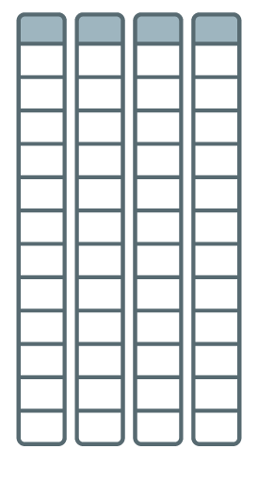



Joining and Combining Data
Example: Find total sales in outlet stores
Stores
Sales
Converts joins of data in multiple tables into fast column scan
  First scan on smaller table creates a Bloomfilter
  Second scan of larger table uses Bloomfilter
Joins tables much faster
StoreID in
15, 38, 64
Type
Store ID
Amount
Store ID
Type=Outlet
Sum
Notes:
We have shown that we can scan and filter in-memory data extremely quickly.
But with any new data format we need to be able to join and aggregate the data as well as scan it.
With In-memory vector joins, the join between the stores and sales table can be converted into a scan of the sales
table with the ‘where’ clause predicate on the store table being converted into a filter on the sales table.
This allows us to take full advantage of what In-memory is best for, fast scans and filters.

Slide 15
Silicon Secured Memory
or ADI or ADP or MCD

Slide 16

Heartbleed - Impacted Websites Using OpenSSL
Heartbeat request sent to victim
Type | Payload_size | Payload
HB_REQUEST | 65535 | Hello
Victim responds with requested payload size (64K bytes)
Type | Payload_size | Payload
HB_RESPONSE | 65535 | Hello ………. | ………………….
Payload_size does not match Payload
Unauthorized data returned to requestor
Notes:
Heartbleed is a memory access vulnerability discovered in the popular OpenSSL cryptography library.
It results from improper input validation (due to a missing bounds check) in the TLS heartbeat extension.
The Heartbeat Extension tests TLS/DTLS secure communication links by allowing a computer at one end of
a connection to send a "Heartbeat Request" message, consisting of a payload, typically a text string, along
with the payload's length as a16-bit integer. The receiving computer then must send exactly the same payload
back to the sender. The affected versions of OpenSSL allocate a memory buffer for the message to be returned
based on the length field in the requesting message, without regard to the actual size of that message's payload.
Without proper bounds checking, the message returned consists of the payload, possibly
followed by whatever else happened to be in the allocated memory buffer.
Heartbleed is therefore exploited by sending a malformed heartbeat request with a small payload and large length
field to the vulnerable party (usually a server) in order to elicit the victim's response, permitting attackers to read
up to 64KB of the victim's memory that was likely to have been used previously by OpenSSL.
Based on examinations of audit logs by researchers, it has been reported that some attackers may have exploited
the flaw for at least five months before discovery and announcement.
Discovered April 2014 in the OpenSSLL cryptography library by Neel Mehta of Google's security team.
Registered in the Common Vulnerabilities and Exposuress system as CVE-2014-0160.

Slide 17

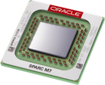

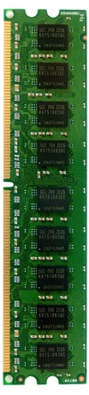

Security In Silicon: Silicon Secured Memory
Protects data in memory
Hidden “color” bits added to pointers (key), and content (lock)
Pointer color (key) must match content color or program is aborted
  Set on memory allocation, changed on memory free’
  Protects against access off end of structure, stale pointer access and
  malicious attacks
Pointer “B”
GO
Pointer “R”
GO
Pointer “Y”
Applications
M7 Processor
Memory

Slide 18
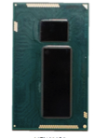



Silicon Secured Memory: Buffer Overflows
Any Processor
SPARC M7 Processor
Pointer
Pointer
Applications
Memory
Applications
Memory

Slide 19
SSM Implementation: Application Data Integrity
version
64Bytes
ld …
st …
version
64Bytes
version
address
H/W compares pointer “key” with memory “lock”
  are 4bit numbers
  called “versions”
Traps if they don’t match
  Sends SEGV or utrap to process
H/W masks “key” before it hits the MMU
version
64Bytes
version
64Bytes
version
64Bytes
version
64Bytes
version
64Bytes
ld …
st …
version
64Bytes
version
address
(dbx) run
signal SEGV (ADI version 13 mismatch for VA 0x4a900) in main at 0x10988
(dbx) where
…stack trace…
Notes:
Just as it's important to have an accurate map when driving, it's important to know the directions to the important data is always right. Why not verify the directions each time the address is looked up?

Slide 20

Silent Data Corruption: Without ADI
Only legal accesses, no issues
Accidentally the blue and the grey process wrote to an area that they should not access
Very likely data got corrupted
But no-one notices…
…until the corrupted data is accessed
save %sp,-104,%sp
mov 9,%l0
add %l0,-1,%l1
add %l0,-7,%o1
mov %l1,%o0
call .umul,0
nop
add %l0,-11,%o1
call .div,0
nop
mov %o0,%l1
ret
restore
save %sp,-104,%sp
mov 9,%l0
add %l0,-1,%l1
add %l0,-7,%o1
mov %l1,%o0
call .umul,0
nop
add %l0,-11,%o1
call .div,0
nop
mov %o0,%l1
ret
restore
save %sp,-104,%sp
mov 9,%l0
add %l0,-1,%l1
add %l0,-7,%o1
mov %l1,%o0
call .umul,0
nop
add %l0,-11,%o1
call .div,0
nop
mov %o0,%l1
ret
restore
Memory shared
among many processes
Notes:
Memory area with boxes around memory associations. The color scheme shows these associations, but there is no mechanism enforcing it or monitoring access!
“Illegal” accesses can occur (malloc reserves space to be used later, and lines all these pieces up in one large contiguous piece)
Click through animations to demonstrate such an access

Slide 21
Prevent Silent Data Corruption With ADI
save %sp,-104,%sp
mov 9,%l0
add %l0,-1,%l1
add %l0,-7,%o1
mov %l1,%o0
call .umul,0
nop
add %l0,-11,%o1
call .div,0
nop
mov %o0,%l1
ret
restore
Memory assignmentsare “color” encoded (can be changed any time dynamically)
Only legal accesses, no issues
Oops, the red and the blue process tried to write to an area that they should not access
ADI notices the illegal access before data corruption can occur
save %sp,-104,%sp
mov 9,%l0
add %l0,-1,%l1
add %l0,-7,%o1
mov %l1,%o0
call .umul,0
nop
add %l0,-11,%o1
call .div,0
nop
mov %o0,%l1
ret
restore
save %sp,-104,%sp
mov 9,%l0
add %l0,-1,%l1
add %l0,-7,%o1
mov %l1,%o0
call .umul,0
nop
add %l0,-11,%o1
call .div,0
nop
mov %o0,%l1
ret
restore
Memory shared
among many processes
Notes:
With ADP the associations can be encoded into memory and the software by assigning numbers to memory and the corresponding processes. The CPU then transparently tracks all memory accesses and compares the number of the process to the number of the memory area.

Slide 22
libadimalloc.so: Linear Overflow Protection for the Masses
ADI is really great at detecting linear overflows
The attacker controls the size of the buffer being written, but not the starting address
  char *ptr;
  ptr = malloc(20);
  strcpy(ptr, argv[1]); /* argv could be bigger than 20 chars */
  The overflowed memory is adjacent to the buffer. Other live buffers, free buffers and potentially metadata may become corrupted
  As long as the buffer adjacent to the one allocated for ptr has a different ADI version, any attempt to overflow will trap
prt[0]
prt[1]
…
prt[19]
prt[20]
prt[21]
malloc’ed area: color 1
adjacent cache line: color 2
Notes:
Now we move over to libadimalloc. Here one can see a common example of how buffer overflows can happen: strcpy has a brother named strncpy, which should be preferred because it also checks the strings lengths. In the example given the contents of argv[1] is copied to ptr regardless of how much space was reserved
The diagram shows the coloring scheme libadimalloc uses: it ensures that each malloc’ed buffer *ends* on a 64bit boundary. Since memory allocations in existing programs can be of arbitrary length one has to choose if an allocation starts, ends, or is somewhere in between 64bit boundaries (the color/version can only change on a 64bit boundary!) We choose to let it end on a 64bit boundary to immediately detect a read beyond a buffer (which is the most common case) In theory one could read the area ahead of a buffer by subtracting from the pointer, but still no data would be leaked out since the preceding buffer would have ended on the preceding 64bit boundary. The only downside is that one will not be noticed by ADI of this “read ahead”
The 64bit boundary alignment also causes a growth in the memory footprint of an existing binary when run with libadimalloc

Slide 23
Example Use of libadimalloc.so
Demo Code
#include <stdio.h>
#include <stdlib.h>
int
main(void){
char* public = (char*)malloc(sizeof(char)*100);
char* secret = (char*)malloc(sizeof(char)*100);
printf("public text -> "); scanf("%s", public);
printf("secret text -> "); scanf("%s", secret);
for(int ii = 0; ii < 150; ii++)
printf("%c\n", public[ii]);
printf("\n");
return 0;
}
Obvious Buffer Overflow (read beyond end)
“public” buffer is 100bytes wide
Code reads 150bytes
  50bytes are read from adjacent buffer

Slide 24
Output of Demo
On any system
On a SPARC M7 using libadimalloc.so
martimue@SPARC-M7,ADI>./malloc
public text -> hello
secret text -> secret
h
e
l
l
o
---snip---
s
e
c
r
e
t
---snip---
martimue@SPARC-M7,ADI>
martimue@SPARC-M7,ADI>
LD_PRELOAD=libadimalloc.so ./malloc
public text -> hello
secret text -> secret
h
e
l
l
o
---snip---
Segmentation Fault (core dumped)
martimue@SPARC-M7,ADI>
Notes:
If this binary is run on any system the secret string is (accidentally) dumped. If the exact same binary (that could have been compiled on any 64bit SPARC system) is run on a M7 based system with libadimalloc preloaded it will core dump the moment it tries to read beyond the “public” buffer. The Solaris Studio 12.5 debugger dbx could then be used to find out why the binary crashed and dbx ./malloc core would point to the for loop (if –g was given during compile) or a ld instruction that tried to read beyond the buffer

Slide 25
ADI Caveats
64-bit processes only
Performance impact
  Negligible for the default disrupting traps
  Optional precise traps for store mismatches have a noticeable impact, should only be used for debug
  Updating versions is negligible
Normalize pointers before
  compare
  arithmetical operations
ADI has a high probability of catching bugs, but a bad pointer may accidentally have a matching version
DMA read (write to memory) resets ADI version to 0
  Impacts userland only if Direct I/O is used

Slide 26
Advancing the State-of-the-Art: Always-On Security in Silicon Always-On Memory Protection and Encryption Pushed Down the Stack into Silicon
First Converged Infrastructure in Silicon
World’s Fastest Microprocessor
Most Advanced Security Platform
Always-on Memory Intrusion Protection & wide key encryption
Hardware SQL acceleration, Compression, Encryption
More cores, threads, memory
& IO Bandwidth w/lower latency
Notes:
Zero performance penalty

Slide 27
Benchmark Disclosure Statement
Copyright 2015, Oracle &/or its affiliates. All rights reserved. Oracle & Java are registered trademarks of Oracle &/or its affiliates. Other names may be trademarks of their respective owners
SPEC and the benchmark name SPECjEnterprise are registered trademarks of the Standard Performance Evaluation Corporation. Results from www.spec.org as of 10/25/2015. SPARC T7-1, 25,818.85 SPECjEnterprise2010 EjOPS (unsecure); SPARC T7-1, 25,093.06 SPECjEnterprise2010 EjOPS (secure); Oracle Server X5-2, 21,504.30 SPECjEnterprise2010 EjOPS (unsecure); IBM Power S824, 22,543.34 SPECjEnterprise2010 EjOPS (unsecure); IBM x3650 M5, 19,282.14 SPECjEnterprise2010 EjOPS (unsecure).
SPEC and the benchmark name SPECvirt_sc are registered trademarks of the Standard Performance Evaluation Corporation. Results from www.spec.org as of 10/25/2015. SPARC T7-2, SPECvirt_sc2013 3026@168 VMs; HP DL580 Gen9, SPECvirt_sc2013 3020@168 VMs; Lenovo x3850 X6; SPECvirt_sc2013 2655@147 VMs; Huawei FusionServer RH2288H V3, SPECvirt_sc2013 1616@95 VMs; HP ProLiant DL360 Gen9, SPECvirt_sc2013 1614@95 VMs; IBM Power S824, SPECvirt_sc2013 1371@79 VMs.
SPEC and the benchmark names SPECfp and SPECint are registered trademarks of the Standard Performance Evaluation Corporation. Results as of October 25, 2015 from www.spec.org and this report. 1 chip resultsSPARC T7-1: 1200 SPECint_rate2006, 1120 SPECint_rate_base2006, 832 SPECfp_rate2006, 801 SPECfp_rate_base2006; SPARC T5-1B: 489 SPECint_rate2006, 440 SPECint_rate_base2006, 369 SPECfp_rate2006, 350 SPECfp_rate_base2006; Fujitsu SPARC M10-4S: 546 SPECint_rate2006, 479 SPECint_rate_base2006, 462 SPECfp_rate2006, 418 SPECfp_rate_base2006. IBM Power 710 Express: 289 SPECint_rate2006, 255 SPECint_rate_base2006, 248 SPECfp_rate2006, 229 SPECfp_rate_base2006; Fujitsu CELSIUS C740: 715 SPECint_rate2006, 693 SPECint_rate_base2006; NEC Express5800/R120f-1M: 474 SPECfp_rate2006, 460 SPECfp_rate_base2006.
SPEC and the benchmark name SPEC OMP are registered trademarks of the Standard Performance Evaluation Corporation. Results as of October 25, 2015 from www.spec.org and this report. SPARC T7-4 (4 chips, 128 cores, 1024 threads): 27.9 SPECompG_peak2012, 26.4 SPECompG_base2012; HP ProLiant DL580 Gen9 (4 chips, 72 cores, 144 threads): 21.5 SPECompG_peak2012, 20.4 SPECompG_base2012; Cisco UCS C460 M7 (4 chips, 72 cores, 144 threads): 20.8 SPECompG_base2012.
Two-tier SAP Sales and Distribution (SD) standard application benchmarks, SAP Enhancement Package 5 for SAP ERP 6.0 as of 10/23/15: SPARC T7-2 (2 processors, 64 cores, 512 threads) 30,800 SAP SD users, 2 x 4.13 GHz SPARC M7, 1 TB memory, Oracle Database 12c, Oracle Solaris 11, Cert# 2015050. IBM Power System S824 (4 processors, 24 cores, 192 threads) 21,212 SAP SD users, 4 x 3.52 GHz POWER8, 512 GB memory, DB2 10.5, AIX 7, Cert#201401. Dell PowerEdge R730 (2 processors, 36 cores, 72 threads) 16,500 SAP SD users, 2 x 2.3 GHz Intel Xeon Processor E5-2699 v3 256 GB memory, SAP ASE 16, RHEL 7, Cert#2014033. HP ProLiant DL380 Gen9 (2 processors, 36 cores, 72 threads) 16,101 SAP SD users, 2 x 2.3 GHz Intel Xeon Processor E5-2699 v3 256 GB memory, SAP ASE 16, RHEL 6.5, Cert#2014032. SAP, R/3, reg TM of SAP AG in Germany and other countries. More info www.sap.com/benchmark
Additional Info: http://blogs.oracle.com/bestperf

